Slide 1
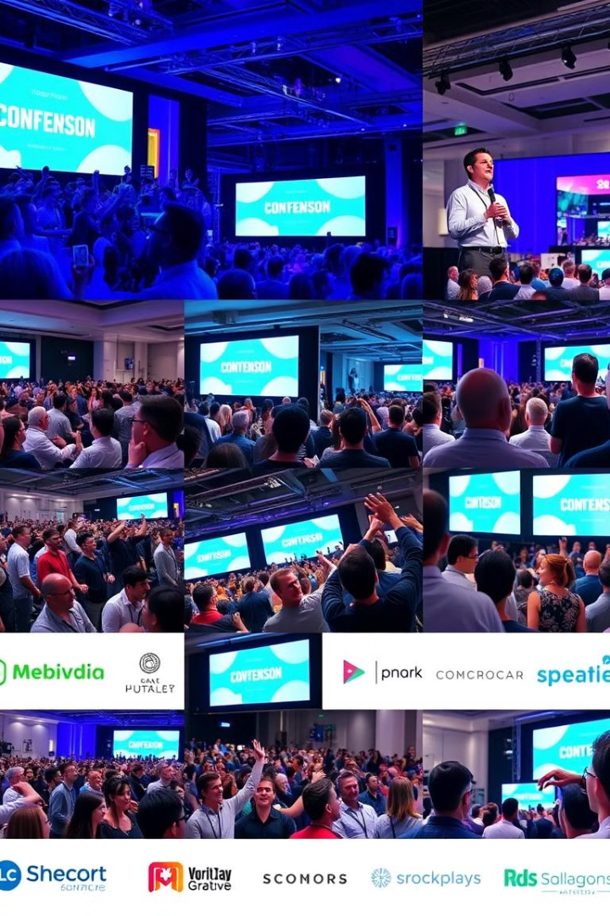
Homepage Design: Image & Video Focus
Discover a visually stunning homepage design focused on images and videos. Our innovative design creates an engaging experience that captures the essence of your event. High-quality visuals, dynamic layouts, and interactive elements keep your audience captivated.

Slide 2
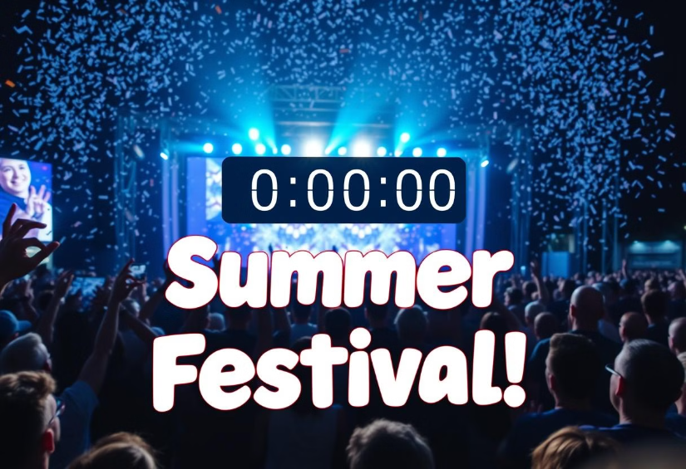
Hero Section: Captivating First Impressions
Background
Full-screen, high-quality image or looping video showcasing event highlights. Crowds, speakers, venue, or creative logo.
Overlay
Bold event title, date, location, and a modern countdown timer. Circular or linear progress indicator.
Navigation
Sticky top menu bar with smooth scrolling ensures easy access to all sections of the website.

Slide 3
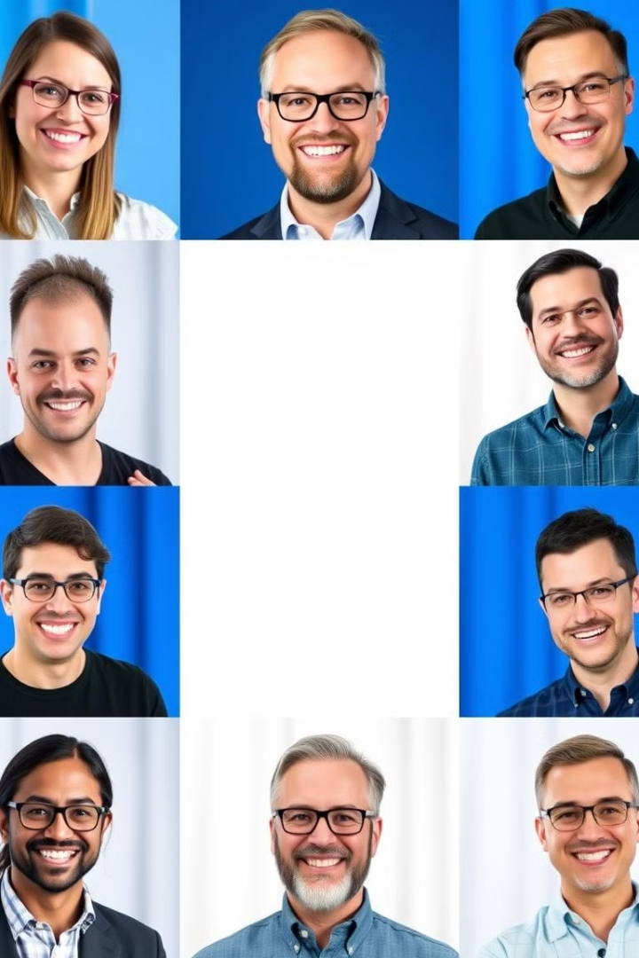



Speaker Showcase: Dynamic Grid Layout
Speaker Details
Interactive Profiles
Design Elements
Name, professional title, and area of expertise. Examples: motion graphics, visual storytelling.
Clickable profile links to a detailed speaker page. Short bio, session topics, and intro video.
Hover effects reveal more speaker details. Clean, modern style with vibrant colors.

Slide 4
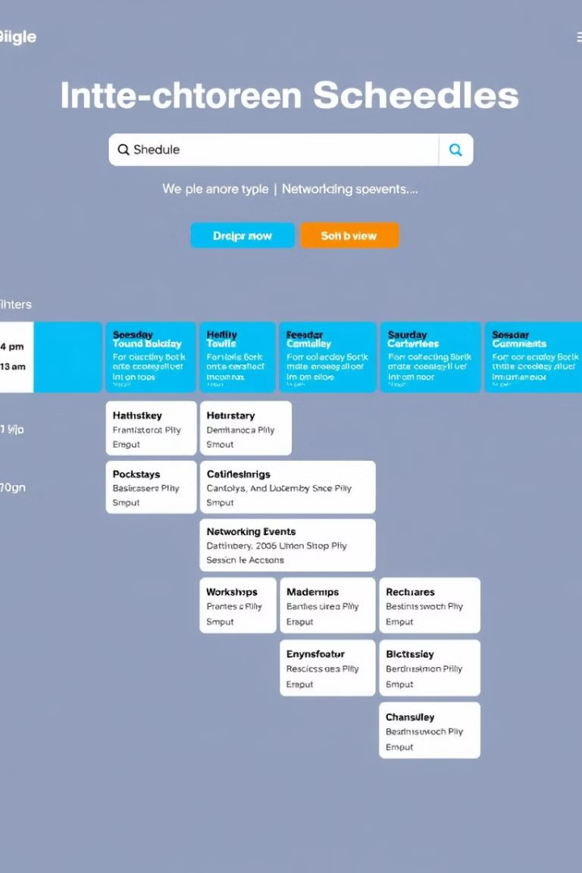



Interactive Schedule Page: Visual Timeline
Timeline
Horizontal scrolling timeline for mobile. Vertical grid for desktop.
Grid View
Color-coded session blocks. Icons for session types like keynote or panel.
Interactive
Sort by tracks or days using dropdown menus or toggles.

Slide 5
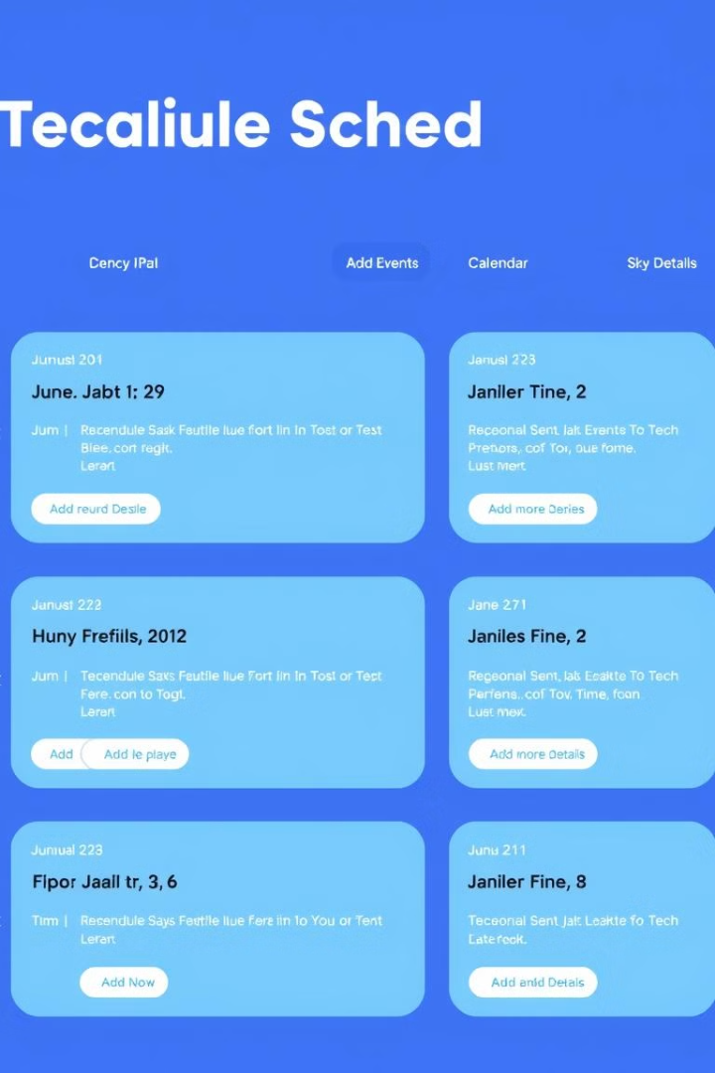



Schedule Page: Visual Engagement & Navigation
Filters & Sorting
Tooltips
Use dropdowns or toggles to sort by tracks or days.
Hover over sessions for additional details on the schedule.
Speaker Icons
Add clickable thumbnails of speakers next to their sessions.
Prioritize a responsive and visually cohesive design. Resonates with the creative nature of the event while maintaining easy navigation.

